Slide 1

Presentation on
NETWORKS
RENAISSANCE SOFTLABS PVT. LTD.
www.renintech.com

Slide 2
Drawbacks Of PSTN Networks
Use of Circuit Switching
Limited number of channels
Silence Periods
Call Setup Procedure
Billing
Lack of Advanced Features

Slide 3
Circuit Switching
Network resources (e.g., bandwidth)
divided into “pieces”
Dividing link bandwidth into “pieces”
  frequency division
  time division
Pieces allocated to calls
Resource piece idle if not used by owning call (no sharing)

Slide 4
FDMA and TDMA
Example:
FDMA
4 users
frequency
time
TDMA
frequency
time

Slide 5
Packet Switching
Each end-end data stream divided into packets
User A, B packets share network resources
Each packet uses full link bandwidth
Resources used as needed
Resource contention:
Aggregate resource demand can exceed amount available
Congestion: packets queue, wait for link use
store and forward: packets move one hop at a time
  transmit over link
  wait turn at next link
Bandwidth division into “pieces”
Dedicated allocation
Resource reservation

Slide 6
Packet Switching Networks
Goal: Move packets through routers from source to destination
Datagram network:
  Destination address in packet determines next hop
  Routes may change during session
  Analogy: driving, asking directions
Virtual circuit network:
  Each packet carries tag (virtual circuit ID), tag determines next hop
  Fixed path determined at call setup time, remains fixed thru call
  Routers maintain per-call state

Slide 7
Connection oriented
Typical example:
A telephone conversation
3 step process:
1. Establish connection
  using the signaling protocol
2. Use connection
  using an informal protocol
  being billed for duration of usage
3. Terminate connection
  using the signaling protocol

Slide 8
Connection oriented
A temporary communication channel
is build through the telephone network

Slide 9
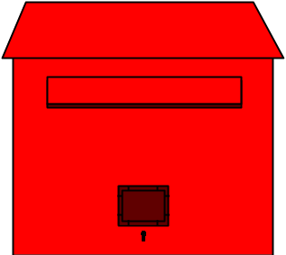

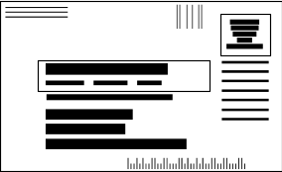
Connectionless
Typical example:
The postal service
Letters, with an address and a stamp,
are individually carried from a
Post office box to a personal mailbox

Slide 10
Advantages Of Data Networks
Packet Switched
Voice Compression
Silence Periods Removal
Call set up procedure
Billing independent of Distance
Advanced Telecom Services

Slide 11
Challenges In VOIP
Reliability
Quality of Service
Stringent delay constraints
Inter arrival Jitter
Loss of Packets
Out of order arrival of Packets
Interoperability
Initial call setup
Security

Slide 12





Internet
Protocols control sending, receiving of msgs
  e.g., TCP, IP, HTTP, FTP, PPP
Internet: “network of networks”
  Loosely hierarchical
  Public Internet versus private intranet
Internet standards
  RFC: Request for comments
  IETF: Internet Engineering Task Force
router
workstation
server
mobile
local ISP
regional ISP
company
network

Slide 13
Internet: A Service oriented View
Communication infrastructure enables distributed applications:
  Web, email, games, e-commerce, database., voting, file (MP3) sharing
Communication services provided to apps:
  connectionless
  connection-oriented

Slide 14
Protocols
Protocols define format, order of msgs sent and received among network entities, and actions taken on msg transmission, receipt
For proper communication, entities in different systems must speak the same language
  Mutually acceptable conventions and rules about
  Content
  Timing
  Underlying mechanisms
Those conventions and associated rules are referred as “PROTOCOLS”

Slide 15


Human Protocol
HI
HI
What is the Time?
2:00 PM

Slide 16

Network Protocol
TCP Request
TCP Reply
http://www.xyz.com/reply.html
<reply.html>

Slide 17
Protocol Architecture
Task of data transfer is broken up into some modules
  Why?
  How do these modules interact?
For example file transfer could use three modules
  File transfer application
  Communication service module
  Network access module
Notes:
Answer to Why? – Same reason as dividing a big program into smaller functions. It is difficult to attack big problems as a whole.
Answer to interaction question? – Modules have a layered structure. Each layer (module) provides service to upper layer and expects service from lower layer. Details are explained later in this ppt file.

Slide 18
Layered Architecture; why?
To reduce complexity of communication task
By Splitting up into layers
Functionality of the layers can be changed
As long as the service provided to the layer above stays unchanged
  makes easier maintenance & updating
Each layer has its own task
Each layer has its own protocol

Slide 19
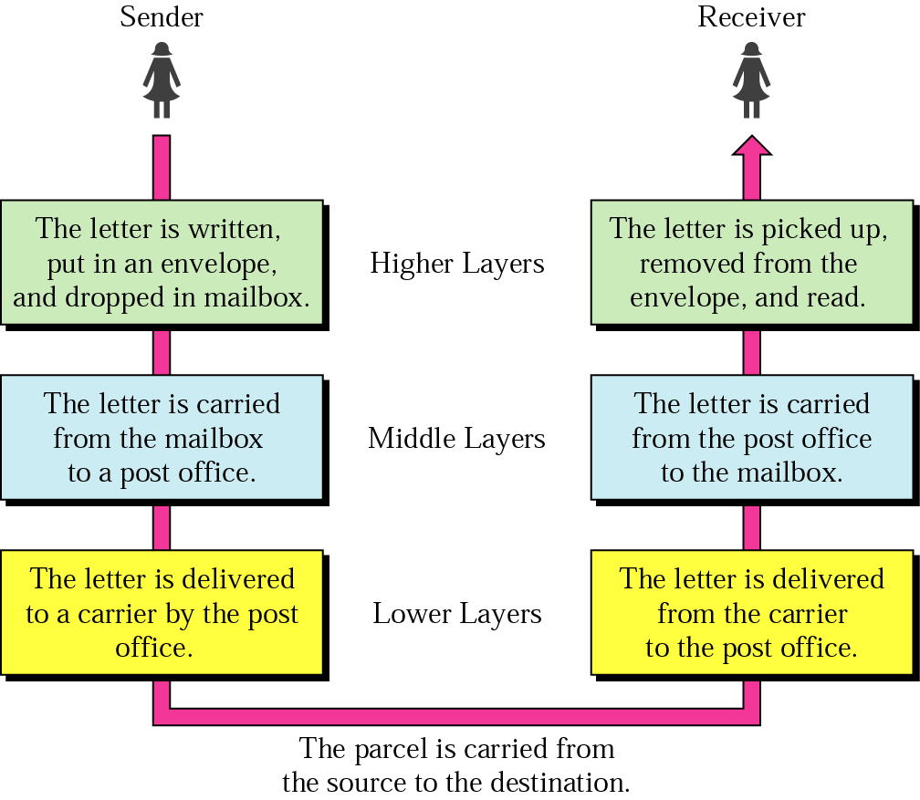




Layered Architecture Daily life Example
Hierarchy?
Services

Slide 20
Layered Architecture Organization of air travel
ticket (purchase)
baggage (check)
gates (load)
runway takeoff
airplane routing
ticket (complain)
baggage (claim)
gates (unload)
runway landing
airplane routing
airplane routing

Slide 21
Distributed implementation of layer functionality
ticket (purchase)
baggage (check)
gates (load)
runway takeoff
airplane routing
ticket (complain)
baggage (claim)
gates (unload)
runway landing
airplane routing
Departing airport
arriving airport
intermediate air traffic sites
airplane routing
airplane routing
airplane routing

Slide 22
OSI Reference Model: What is it?
Open Systems Interconnection Model
Fundamental to communications between network devices.
Developed in 1974 by ISO
Finally adopted in 1977.
It is now the theoretical model for how communication takes place between network devices.

Slide 23
OSI Reference Model
Layer 7
Application
Layer 6
Presentation
Layer 5
Session
Layer 4
Transport
Network
Layer 3
Data Link
Layer 2
Physical
Layer 1

Slide 24
Principles of OSI
Different Level of Abstraction
Each Layer performs a well defined Function
Layers chosen towards standardization
Minimize information across interfaces
Should be large enough and small enough

Slide 25
OSI Layers at Work
Each OSI layer talks with the same layer in the other device
E.g. the Application Layer of Device A communicates with the Application Layer of Device B, by passing the data through the other layers
The Application Layer of each device is not concerned with how the other layers are functioning, but it does rely on them to do their job

Slide 26
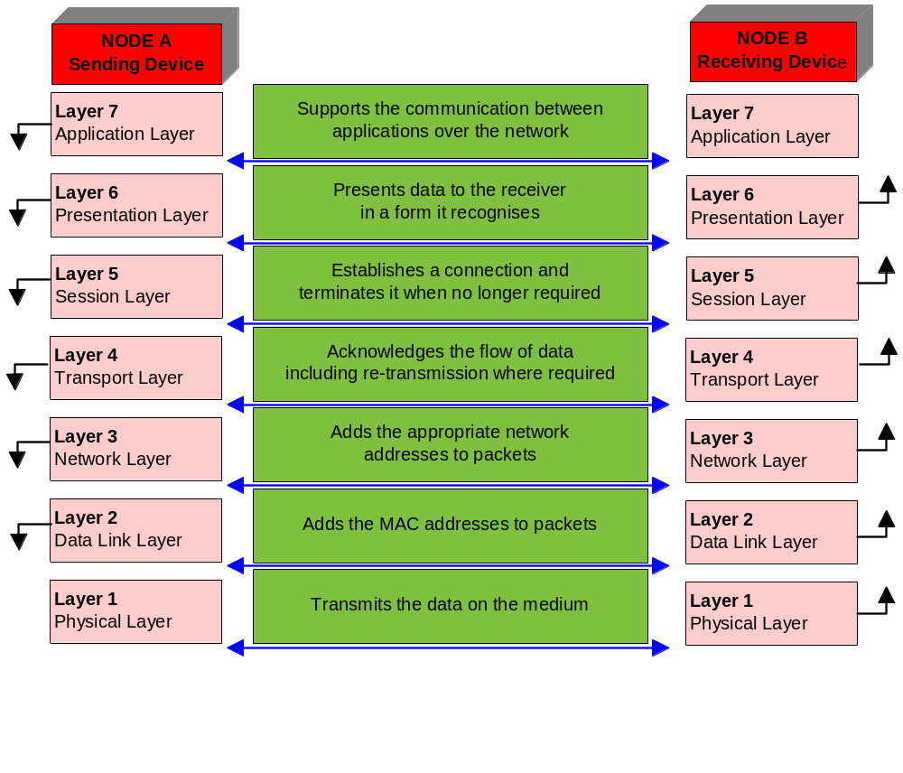
OSI Layers at Work

Slide 27
Remembering the OSI Layers
Application All
        Presentation People
        Session Seem
        Transport To
        Network Need
        Data Link Data
        Physical Processing

Slide 28
Layer 1: Application Layer
Works with the applications you use to communicate over the network
Ex: Services include SMTP, HTTP and FTP
Clicking on a link on a web page issues a command for the browser to retrieve the relevant information from the Internet
In this example your computer is the source, and the host of the web site information is the destination
The application completes your request and delivers the information to your computer

Slide 29
Layer 2: Presentation Layer
Data Presentation
    Understanding Information send
    Conversion of Format
Data Compression
    Reducing volume of Data
    White space removal
    Converting back to original format
Data Encryption
    Hiding the meaning to others
    Not all Data may be encrypted
    Key for Decryption

Slide 30
Layer 3: Session Layer (Functionality)
Responsible for handling the sessions between devices (beginning, maintaining and finishing)
Enforces order in the communication
Regulates the flow of data
It takes responsibility for the following services
  Establishing a Connection
  Maintaining the Session
  Ending the Connection
  Dialogue Control
  Dialogue Separation

Slide 31
Layer 3: Session Layer (Services)
Establishing
Handshaking – SYN and ACK packets
Maintaining
‘Keep alive messages’
Termination
Session must be terminated (otherwise one device will be still transmitting without any device actually listening)
Dialogue Control
simplex, half-duplex, full-duplex
Dialogue Separation
Checkpoints within the transmission which allow the detection of lost packets, and subsequent re-transmission

Slide 32
Layer 4: Transport Layer
Transmission of packets from Source to Destination
Manages the speed of transmission – flow control
Types of transmission
  Connection-Oriented
    Uses Control Packets
    Reliable
    Extra packets slows down Communication
    Retransmissions
  Connectionless
    No Control Packets
    Little or No Reliability
    Faster Transmission
    Packets are not Re-transmitted

Slide 33
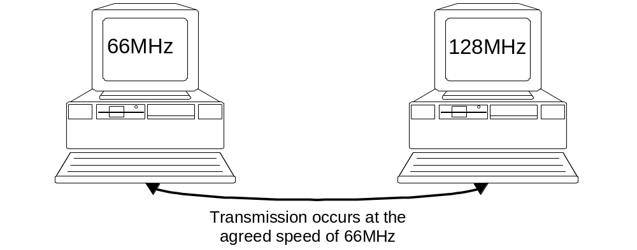
Flow Control
Establishes the maximum speed at which both sender and receiver can communicate
Transport Layer determines largest packet size which can be sent
Packets are numbered – to allow re-assembly in the correct order

Slide 34
Layer 5: Network Layer
Responsible for the correct addressing and delivery of packets of data
Uses the network address (logical address)
Functions:
  Adds address to the packet (encapsulation)
  Maps network address to the devices physical address
  Determines the best path for the packet (routing)
  Ensures that the packet is in the correct format for the destination

Slide 35
Network Layer: How does it work ?
Encapsulation at the Transport Layer involves adding the address of the sender to the datagram
The destination address is now added. Both addresses are logical.
Both addresses are necessary for packets to move between end systems.
If a packet must move to another network, a routing protocol is required
If different packet lengths are used on the different networks, the Network Layer formats the data accordingly
The primary piece of hardware which works on this layer is the router.

Slide 36
Layer 6: Data Link Layer
Has two sub layers of its own:
  Logical Link Control (LLC)
  Media Access Control (MAC)
LLC acts between protocols such as Internet Protocol (IP) and the MAC method.
MAC is responsible for the connection to the physical media (e.g. cable)

Slide 37
MAC
Each NIC has a unique number hard coded in to the card – its physical address
The first 6 digits denote the manufacturer, the next six are unique
When the MAC address is added to the packet it is now known as a frame
It now has all the information required to travel from the source to the destination

Slide 38
Layer 7: Physical Layer
The lowest, bottom, layer – responsible for the physical connection between devices
The NIC converts the data (bits) in to transmission signals.
Transmissions may be analogue or digital
Responsible for the rate of transmission
Includes all components such as the type of connector (RJ-45, Token Ring, BNC, SC connector)
Devices at this level include NICs, repeaters, hubs and concentrators

Slide 39
TCP/IP Model
OSI model is an Reference Model
Protocol in use on modern networks is TCP/IP
TCP/IP does not map its layers precisely to OSI model
OSI = 7 layers, TCP/IP = 4 layers

Slide 40
OSI vs TCP/IP
Application
Presentation
Application or
Process Layer
Session
Transport
Transport
Network
Internet
Data Link
Data Link
Physical

Slide 41
TCP/IP Protocols
Application
Transmission Control Protocol (TCP)
Connection-oriented
User Datagram Protocol (UDP)
Connectionless
File Transfer
TFTP
FTP
E-mail
SMTP
POP3
Remote Login
Telnet
rlogin
Network Management
SNMP
Name Management
DNS
Internet Protocol (IP)
Address Resolution Protocol (ARP)
Reverse Address Resolution Protocol (ARP)
Internet Control Message Protocol (ICMP)
Transport
Ethernet
Fast Ethernet
FDDI
ATM
Internet
Network Access

Slide 42
IP Addressing
An IP addre
ss is a 32-bit sequence of 1s and 0s.
To make the IP address easier to use, the address is usually written as four decimal numbers separated by periods.
This way of writing the address is called the dotted decimal format.
1 1 0 0 0 0 0 0 | 1 0 1 0 1 0 0 0 | 0 0 0 0 0 0 0 1 | 0 0 0 0 1 0 0 0
192 . 168 . 1 . 8

Slide 43
IPv4 Addressing
0 1 8 16 24 31
Class A
0
Network ID
Host ID
Class B
1 0
Network ID
Host ID
Class C
1 1 0
Network ID
Host ID
Class D
1 1 1 0
Multicast Address
Class E
1 1 1 1 0
Reserved

Slide 44
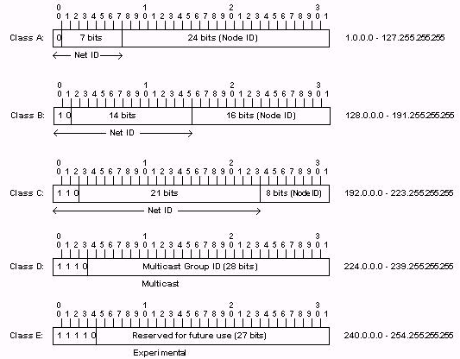
IPv4 Addressing

Slide 45
IPv4 Addressing
Address Class | No. of Networks | Host per Network
A | 126* | 1,62,77,216
B | 16,384 | 65,535
C | 20,97,152 | 254
D (Multicast) | N/A | N/A
AddressClass | High order bits | First Octet Address Range | Bits in NW Address
Class A | 0 | 0 - 127* | 8
Class B | 10 | 128 - 191 | 16
Class C | 110 | 192 - 223 | 24
Class D | 1110 | 224 - 239 | 28

Slide 46
Reserved IP Addresses
Certain host addresses are reserved and cannot be assigned to devices on a network.
An IP address that has binary 0s in all host bit positions is reserved for the network address.
An IP address that has binary 1s in all host bit positions is reserved for the network address.

Slide 47
Reserved IP Addresses
32 Bits
Network | Host
8 Bits
8 Bits
8 Bits
8 Bits
Network
Network
Host
Host
176 . 10 . 0 . 0
Network Address (Host Bits = All 0’s)
8 Bits
8 Bits
8 Bits
8 Bits
Network
Network
Host
Host
176 . 10 . 255 . 255
Broadcast Address (Host Bits = All 1’s)

Slide 48
Public and Private IP Addresses
Public IP addresses are unique because public IP addresses are global and standardized.
Private networks can use any host addresses, as long as each host within the private network is unique.
Three blocks of IP addresses for private, internal use.
Connecting a network using private addresses to the Internet requires translation of the private addresses to public addresses using Network Address Translation (NAT).

Slide 49
Public and Private IP Addresses
Class | RFC 1928 Internal Address Range
A | 10.0.0.0 to 10.255.255.255
B | 172.16.0.0 to 172.31.255.255
C | 192.168.0.0 to 192.168.255.255

Slide 50
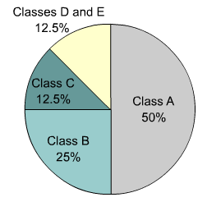
IPv4 versus IPv6
IP version 6 (IPv6) has been defined and developed.
IPv6 uses 128 bits rather than the 32 bits currently used in IPv4.
IPv6 uses hexadecimal numbers to represent the 128 bits.

Slide 51
Obtaining an Internet Address
Static addressing
  Each individual device must be configured with an IP address.
Dynamic addressing
  Reverse Address Resolution Protocol (RARP)
  Bootstrap Protocol (BOOTP)
  Dynamic Host Configuration Protocol (DHCP)

Slide 52
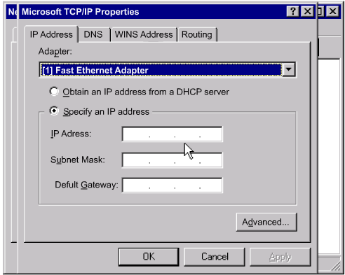
Static Assignment of IP Addresses
Each individual device must be configured with an IP address.

Slide 53
Dynamic Host Configuration Protocol
Allows a host to obtain an IP address
Set of defined IP addresses on a DHCP server.
As hosts come online,
  Contact the DHCP server
  Request an address.

Slide 54
Ports
IANA
Well known Ports 0 – 1023
Registered Ports 1024 – 49151
Private or Dynamic Ports 49152 – 65535
Not strictly enforced
Just a Set of Recommended Uses
Example of Misuse:
Trojan Horse

Slide 55
Well Known PORTS
  FTP (Control) – 21/TCP
  FTP (Data) – 20/TCP
  Telnet – 23/TCP
  DNS – 53/UDP, 53/TCP
  HTTP – 80/TCP
  SNMP – 161/UDP
  POP3 – 110/TCP

Slide 56
Registered PORTS
  RMI – 1099/TCP, 1099/UDP
  Oracle – 1521/TCP
  MS SQL Server – 1433/TCP
  My SQL – 3306/TCP

Slide 57
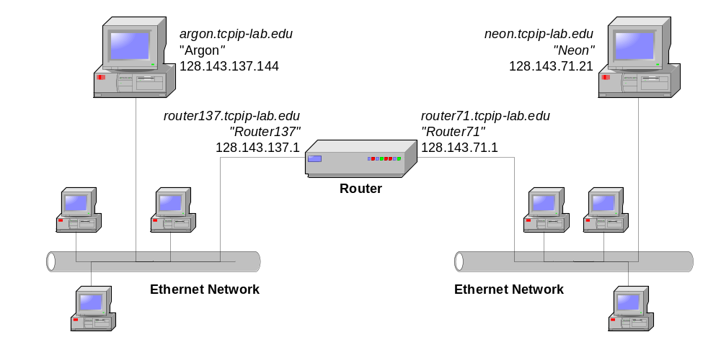
Sending a packet from Argon to Neon
128.143.71.21 is not on my local network.
Therefore, I need to send the packet to my
default gateway with address 128.143.137.1
128.143.71.21 is on my local network.
Therefore, I can send the packet directly.
DNS: What is the IP address
of “neon.tcpip-lab.edu”?
DNS: The IP address of “neon.tcpip-lab.edu” is 128.143.71.21
ARP: What is the MAC address of 128.143.137.1?
ARP: The MAC address of 128.143.137.1 is 00:e0:f9:23:a8:20
ARP: What is the MAC address of 128.143.71.21?
ARP: The MAC address of 128.143.137.1 is 00:20:af:03:98:28
frame
frame

Slide 58
Application Layer Protocols
Difference between Network Protocols and Application Layer Protocols
Concept of User Agent
Examples of Application Layer Protocols:
PING
FTP
HTTP
SMTP
POP3
DNS

Slide 59
Client-server paradigm
Typical network app has two pieces: client and server
application
transport
network
data link
physical
Client:
initiates contact with server (“speaks first”)
typically requests service from server,
Web: client implemented in browser; e-mail: in mail reader
request
reply
application
transport
network
data link
physical
Server:
provides requested service to client
e.g., Web server sends requested Web page, mail server delivers e-mail

Slide 60
PING
Smallest and earliest of Application Protocols
Sends IP Data grams to a specified Host
Measures the round trip times
Traditional Usage

Slide 61
HTTP
Web page consists of objects
Object can be HTML file, JPEG image, Java applet, audio file,…
Web page consists of base HTML-file which includes several referenced objects
Each object is addressable by a URL
Example URL:
www.someschool.edu/someDept/pic.gif
host name
path name

Slide 62
HTTP Overview
HTTP: hypertext transfer protocol
Web’s application layer protocol
client/server model
  client: browser that requests, receives, “displays” Web objects
  server: Web server sends objects in response to requests
HTTP 1.0: RFC 1945
HTTP 1.1: RFC 2068
HTTP request
PC running
Explorer
HTTP response
HTTP request
Server
running
Apache Web
server
HTTP response
Mac running
Navigator

Slide 63
HTTP request message
Two types of HTTP messages: request, response
HTTP request message:
  ASCII (human-readable format)
request line
(GET, POST,
HEAD commands)
GET /somedir/page.html HTTP/1.1
Host: www.someschool.edu
User-agent: Mozilla/4.0
Connection: close
Accept-language:fr
(extra carriage return, line feed)
header
lines
Carriage return,
line feed
indicates end
of message

Slide 64
HTTP response message
status line
(protocol
status code
status phrase)
HTTP/1.1 200 OK
Connection close
Date: Thu, 06 Aug 1998 12:00:15 GMT
Server: Apache/1.3.0 (Unix)
Last-Modified: Mon, 22 Jun 1998 …...
Content-Length: 6821
Content-Type: text/html
data data data data data ...
header
lines
data, e.g.,
requested
HTML file

Slide 65
HTTP Requests
HTTP/1.1
GET, POST, HEAD
PUT
  uploads file in entity body to path specified in URL field
DELETE
  deletes file specified in the URL field

Slide 66
HTTP response status codes
In first line in server->client response message.
A few sample codes:
200 OK
  request succeeded, requested object later in this message
301 Moved Permanently
  requested object moved, new location specified later in this message (Location:)
400 Bad Request
  request message not understood by server
404 Not Found
  requested document not found on this server
505 HTTP Version Not Supported

Slide 67
Simple Mail Transfer Protocol (SMTP)
E-mail is probably the most widely used TCP/IP application
A standard for exchange of mail between two computers
A standard (STD 11) on the format of the mail messages
A standard for the routing of mail using the Domain Name System

Slide 68
SMTP Components
outgoing
message queue
Three major components:
  User Agents
  Mail Servers
  Simple Mail Transfer Protocol: SMTP
user mailbox
user
agent
mail
server
user
agent
SMTP
mail
server
user
agent
SMTP
SMTP
mail
server
user
agent
user
agent
user
agent

Slide 69
SMTP Working
Uses TCP to reliably transfer email message from client to server, port 25
direct transfer: Sending server to Receiving server
Three phases of transfer
  Handshaking (greeting)
  Transfer of messages
  Closure
Command/Response interaction
  Commands: ASCII text
  Response: status code and phrase
Messages must be in 7-bit ASCII

Slide 70

Scenario: Alice sends Mail to Bob
1) Alice uses UA to compose message and “to” bob@someschool.edu
2) Alice’s UA sends message to her mail server; message placed in message queue
3) Client side of SMTP opens TCP connection with Bob’s mail server
4) SMTP client sends Alice’s message over the TCP connection
5) Bob’s mail server places the message in Bob’s mailbox
1
mail
server
mail
server
user
agent
2
3
4
5

Slide 71
SMTP Message Format
SMTP: protocol for exchanging email msgs
RFC 822: standard for text message format:
header lines, e.g.,
  To:
  From:
  Subject:
  different from SMTP commands!
body
  the “message”, ASCII characters only
header
blank
line
body

Slide 72
MIME – Multimedia Extensions
MIME: Multipurpose Internet mail extension,
RFC 2045, 2056
Additional lines in message header declare MIME content type
From: alice@crepes.fr
To: bob@hamburger.edu
Subject: Picture of yummy crepe.
MIME-Version: 1.0
Content-Transfer-Encoding: base64
Content-Type: image/jpeg
base64 encoded data .....
.........................
......base64 encoded data
MIME version
method used
to encode data
multimedia data
type, subtype,
parameter declaration
encoded data

Slide 73
MIME Types
Text
example subtypes: plain, html
Image
example subtypes: jpeg, gif
Audio
example subtypes: basic (8-bit mu-law encoded), 32kadpcm (32 kbps coding)
Video
example subtypes: mpeg, quicktime
Application
other data that must be processed by reader before “viewable”
example subtypes: msword, octet-stream

Slide 74
SMTP Architecture
User
Sender’s
SMTP
SMTP
Commands
Receiver's
SMTP
User
File
System
File
System
Replies

Slide 75
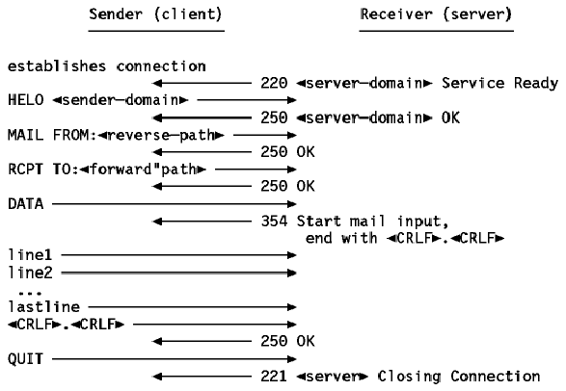
Call Flow

Slide 76

Mail access protocols
SMTP
SMTP
access
protocol
user
agent
user
agent
sender’s mail
server
receiver’s mail
server
SMTP: delivery/storage to receiver’s server
Mail access protocol: retrieval from server
  POP: Post Office Protocol [RFC 1939]
    authorization (agent <-->server) and download
  IMAP: Internet Mail Access Protocol [RFC 1730]
    more features (more complex)
    manipulation of stored msgs on server
  HTTP: Hotmail , Yahoo! Mail, etc.

Slide 77
POP3 protocol
S: +OK POP3 server ready
C: user bob
S: +OK
C: pass hungry
S: +OK user successfully logged on
authorization phase
client commands:
  user: declare username
  pass: password
server responses
  +OK
  -ERR
transaction phase, client:
list: list message numbers
retr: retrieve message by number
dele: delete
quit
C: list
S: 1 498
S: 2 912
S: .
C: retr 1
S: <message 1 contents>
S: .
C: dele 1
C: retr 2
S: <message 1 contents>
S: .
C: dele 2
C: quit
S: +OK POP3 server signing off

Slide 78
POP3 and IMAP
More about POP3
Previous example uses “download and delete” mode.
Bob cannot re-read e-mail if he changes client
“Download-and-keep”: copies of messages on different clients
POP3 is stateless across sessions
IMAP
Keep all messages in one place: the server
Allows user to organize messages in folders
IMAP keeps user state across sessions:
  names of folders and mappings between message IDs and folder name

